Slide 1
IBM Data Science Capstone
Final Presentation

Slide 2
Problem Statement
Identify best places to start new “pocket-friendly menus” restaurants by Bangalore based startup <<Codename XYZ>>

Slide 3
Approach
STEP 1
Data identification and acquisition
STEP 2
Data wrangling (preparing data for further use)
STEP 3
Data analysis and visualization
STEP 4
Drafting Recommendations

Slide 4
Data acquisition and cleaning
Geographical data about Bangalore (Lat/Long information)
Name of competing providers
Location of their operations
Type of services they provide
Customer responses to their services / products

Slide 5
Data acquisition and cleaning (contd)
Data collected from Foursquare (www.foursquare.com)
Limit of 200 and Radius of 5000 set
Initial data set consisted of 100 rows and 5 columns
Merged categories to eliminate overlapping categories
Converted categorical data into numeric binaries

Slide 6
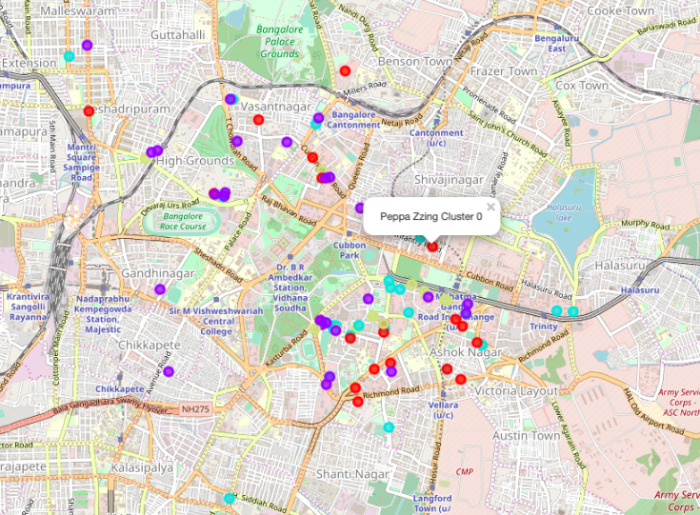
KMeans Clustering
K=4

Slide 7
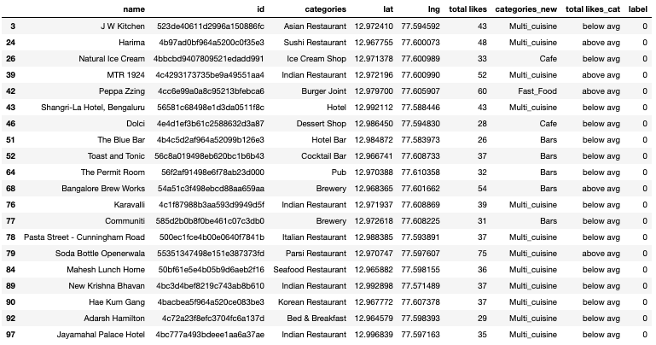
Observations: Cluster 1
Best mix of eating joints but ratings are not good

Slide 8
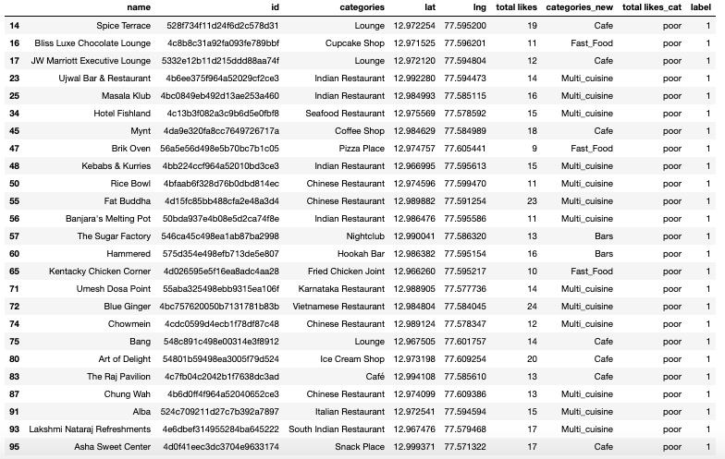
Observations: Cluster 2
Maximum joints with “poor” rating

Slide 9
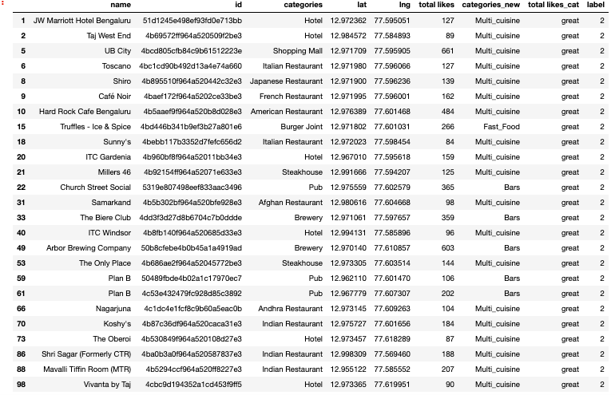
Observations: Cluster 3
Best restaurants in the city

Slide 10
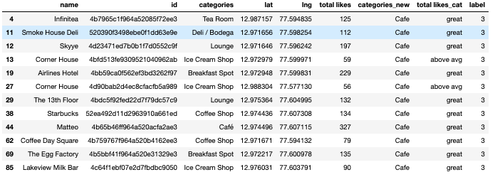
Observations: Cluster 4
Largely Cafes that have good rating

Slide 11
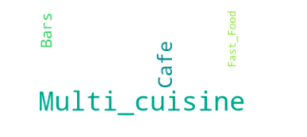
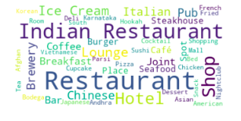
Observations: WordCloud
Multi-cuisine restaurants preferred
Indian food is favourite

Slide 12
Recommendations
Preferred location is around restaurants in Cluster 2
Maximise on the lack of quality of competing eatries
Restaurant must cater to multi-cuisines
Focus should be on Indian cuisine

